Slide 1
GAMMs for LVC
Caitlin Halfacre
Manchester Metropolitan University

Slide 2
Generalised Additive Mixed Model
Notes:
Dynamic = over time – can be short (formant trajectory) or long (lifespan) or in between (pitch track)

Slide 3
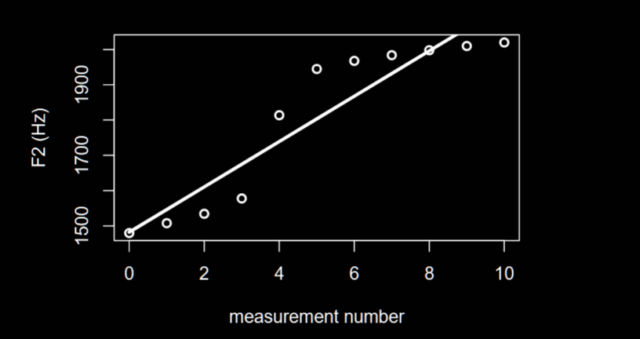
Linear regression
model <- lm(F2 ~ measurement.no, data)

Slide 4
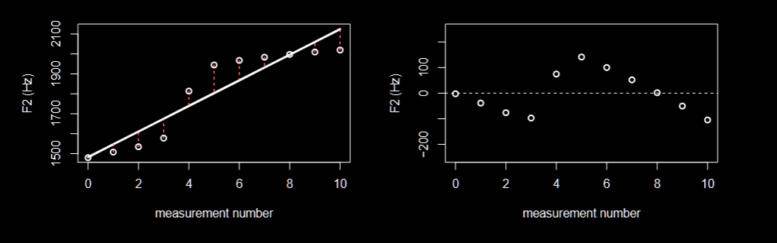
Linear regression
model <- lm(F2 ~ measurement.no, data)

Slide 5
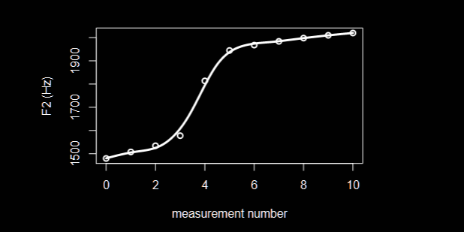
Generalised Additive Mixed Model
model <- bam(F2 ~ s(measurement.no, bs = “cr”), data)

Slide 6
Generalised Additive Mixed Model
Notes:
Dynamic = over time – can be short (formant trajectory) or long (lifespan) or in between (pitch track)

